Slide 1

Android Studio
The hardest IDE to understand - EVER

Slide 2

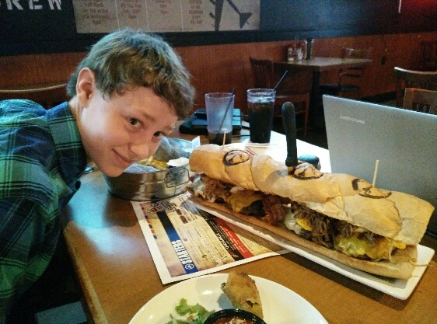
The “Installation”
We began work on the BMI Calculator at B-52’s on a Sunday morning. On that morning, we got the plan for the project completed, along with installing the IDE on to everyone’s computer. I think it would be safe to say that we spent most of the time eating, and watching a progress bar.

Slide 3
The Alpha VS. Beta prototypes
Alpha Prototype
Beta Prototype
The first prototype we had for the BMI Calculator was absolutely awful. It was unable to maintain a simple task. For example, if you touched the screen, the app would crash!
The fix: scrapping the project, and starting again.
2ND prototype, or 1st working prototype was able to accept an on click, use buttons, text boxes, etc. It could perform a simple task, but when we assigned it to display a float, it displayed only the integer value of it.
The fix: Changing the display from int to float with String formatter.

Slide 4
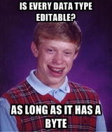
Adding Editable Values
To add editable values, we had to use the toString function. This finally allowed us to begin incorporation of the BMI.

Slide 5
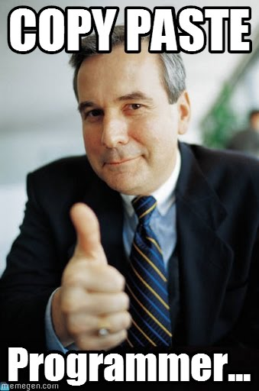
Calculation & Display
For the calculation, we copied and pasted our code from the BMI project earlier in the course. Then we added better GUI design, custom icon, enhanced padding between fields, and altered the colour scheme. We now had a finished project!

Slide 6




[HIP, HIP]
Are you ready to see the finished product?

